Slide 1
GROCERY STORE MANAGEMENT SYSTEM
-DONE BY
LUV KANODIA

Slide 2
INTRODUCTION
Grocery Store Management System is a very useful software used for various purposes of the shopkeepers.
It can be modified according to the needs of the owner .
It serves the widespread scopes in making the work and maintaining the record easier.
Its is not only useful for owner , but it is also useful for the customer un the way of handling it.

Slide 3
HOW IT WORKS
It works on the basic principle of the linking python and a database .
At first , the command will be given in python software afterwards the Comdata base the command will fetch the demanded data and it will it to the python software.
Command will be sent to the database.
There in the Then the required output will be shown the python software.

Slide 4
SOURCE CODE
import mysql.connector as sq
import datetime
d_day=datetime.date.today()
d_time=datetime.datetime.now()
conn=sq.connect(host='localhost', user = 'root', password ='luv123',database ='account')
c1=conn.cursor()
print(" ","GROCERY STORE MANAGEMENT SYSTEM")
print(d_day.day,"/",d_day.month,"/",d_day.year," ",d_time.hour,":",d_time.minute,)
chpasswd='d'
while 5>1:
print(" ","1.LOGIN")
print(" ","2.REGISTER")
print(" ","3.VIEW ALL USERS")
print(" ","4.CHANGE PASSWORD")
print(" ","5.EXIT")

Slide 5
choice=int(input('ENTER THE CHOICE:'))
print("===========================================================================================================================================================================")
if choice == 1:
us=input('USERNAME:')
ps=input('PASSWORD:')
c1.execute("select * from user where username = '{}' and passwd = '{}'".format(us , ps))
data = c1.fetchall()
if any(data) :
import mains
else:
print(" ",'''.............SORRY............
............WRONG USERNAME OR PASSWORD...............''')

Slide 6
elif choice == 2:
print("===========================================================================================================================================================================")
li=input('ENTER THE NEW USERNAME:')
while 8>1:
li2=input('ENTER YOUR PASSWORD:')
li3=input('ENTER YOUR PASSWORD AGAIN(to confirm):')
if li2== li3:
c1.execute("insert into user values("+'"'+li+'",'+'"'+li3+'")')
print("ID has been successfully created:")
conn.commit()
break
elif choice ==3:
c1.execute("select username from user")
data = c1.fetchall()
for row in data : print(row)

Slide 7
elif choice == 4:
print("===========================================================================================================================================================================")
a=input('USERNAME:')
b=input('EXISTING PASSWORD:')
c1.execute("select * from user where username = '{}' and passwd = '{}'".format(a , b))
data = c1.fetchall()
if any(data) :
c=input("ENTER NEW PASSWORD:")
c1.execute("update user set passwd=" + str(c) + " where username="+str(a))
else:
print('''..SORRY..
WRONG.......USERNAME OR PASSWORD''')

Slide 8
elif choice == 5:
print(".......................LOGGING...........OUT................")
break
else:
print('please enter the right option')

Slide 9
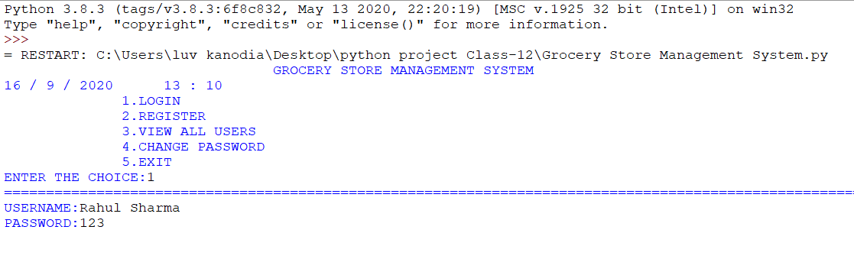
OUTPUT:

Slide 10
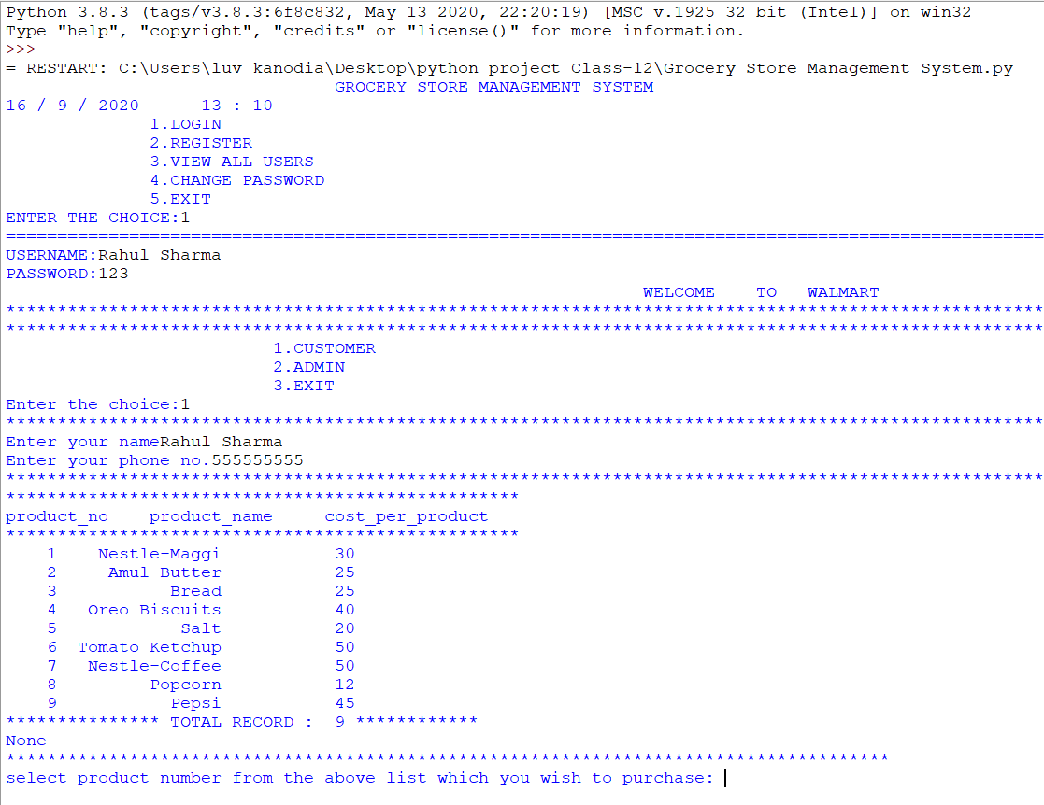

Slide 11
FUTURESCOPE:
In future this software will be there in a high demand as the every thing is getting advanced.
If this software is developed with help of a big database like MySQL , the software’s demand will further increase.
As this software is very cheap, its affordability will be more.

